Slide 1
Measurment

Slide 2
What is measurement ?
The process of using numbers to describe a quantity of process. All numbers must have a unit of measure.

Slide 3
Why is measurement important?
Measurement allows us to describe processes and events.

Slide 4
Length-
The distance between two points.
Tools: Ruler, meter stick or tape measure.
Units : meters (m), centimeters (cm), millimeters (mm), or kilometers (km).

Slide 5
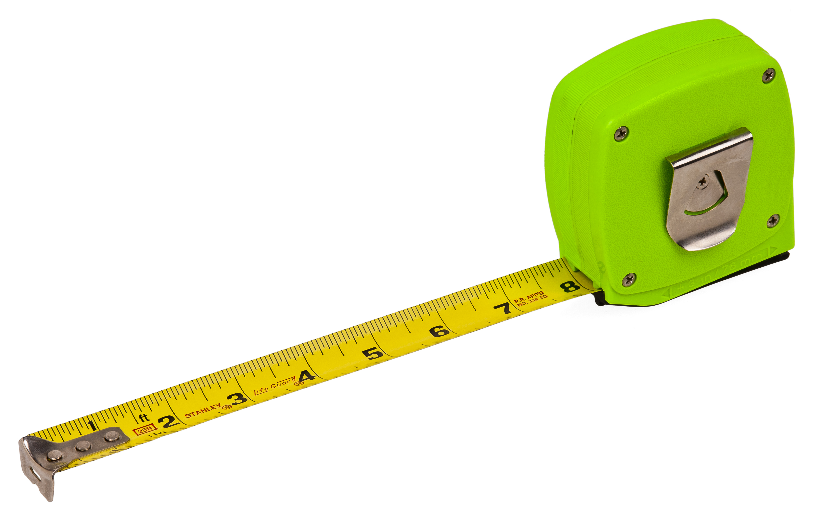
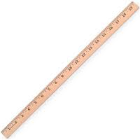

Slide 6
Time -
The interval between two events.
Tools: clock, stopwatch or timer
Units: hours (h), minutes (min.), or seconds (sec).

Slide 7
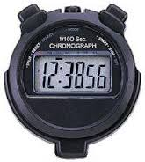
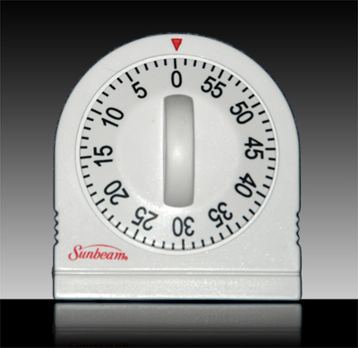

Slide 8
Mass
The amount of matter in an object
Tools: Triple Beam Balance
Units: grams (g), milligrams (mg), or kilograms (kg)

Slide 9
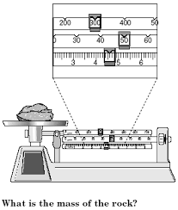

Slide 10
Temperature-
The amount of energy within a sample of matter.
Tools: Thermometer
Units: Celsius (˚C), Fahrenheit (˚F), or Kelvin (˚K)

Slide 12
Volume -
The amount of space an object takes up.
Tools:
A ruler for regulary objects (length x Width x height)
A graduated cylinder for irregulary objects (water displacement method)
A graduated cylinder for liquids ( reading the meniscus)
Units: centimeters cubed (cm3), liters (L), or milliliters (mL).

Slide 13
Irregular vs Regular
Irregular : Rocks, Scissors, Glue, Pebble, Marble, You , etc…
Regular : Squares, Rectangles

Slide 14
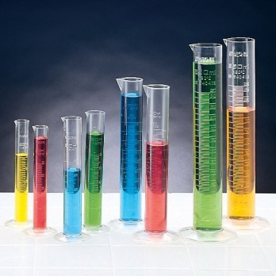

Slide 15
Metric System-
A base-ten system.
Sometimes called the International System of Units or abbreviated as SI.
Examples : millimeter , centimeter, meter, Kilometer, Celcius, gram, milliliter , liter

Slide 16
US Customary Units –
Standard units of measurement commonly used in the United States.
Examples : gallons, ounces, pound, inches, feet, yard, mile, cups

